Slide 1

Introduction to hive
By Vasanti Mahajan

Slide 2
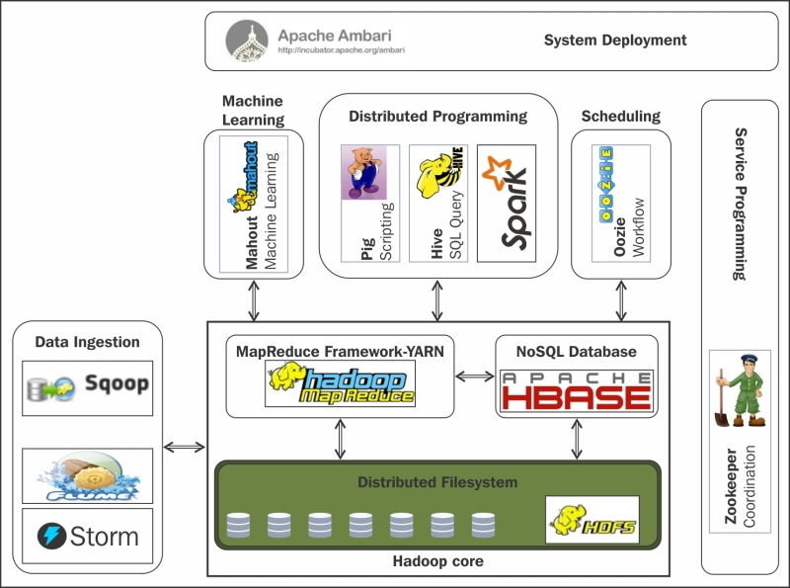
APACHE HADOOP ECOSYSTEM
Different ways of performing MapReduce operations:
Building a Java MapReduce program to process structured, semi-structured, and unstructured data
Building scripts in Pig to process structured and semi-structured data
Using HiveQL for MapReduce to process structured data using Hive

Slide 3
About hive
Apache Hive is a data warehouse infrastructure built on top of Hadoop for providing data summarization, query, and analysis. Hive gives an SQL-like interface to query data stored in various databases and file systems that integrate with Hadoop
Apache Hive provides the following features:
Access to files stored in Apache HDFS, Amazon S3, Apache HBase
Uses SQL-like language (HiveQL) which enables query execution via Apache Tez, Apache Spark, or MapReduce
Supports data in different formats such as, text files, Sequence files (key/value paired), RCFiles (stores columns of the table in the way columnar database stores data)
It is more suitable for running batch jobs over large sets of data i.e OLAP operations rather than OLTP operations

Slide 4
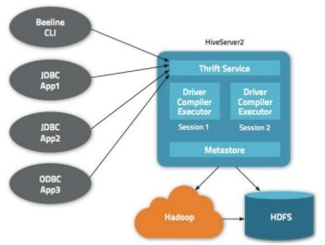
Hive architecture
Components and their interaction:
METASTORE: Stores the metadata for each of the table such as their schema, location, data types, HDFS mapping
DRIVER: Receives the HiveQL statements, creates a session and starts the execution of statements, monitors the life cycle and progress of execution. Stores the metadata that is generated in the metastore. Fetches the results generated by the Reduce operation. Driver has its components namely, Compiler, Optimizer and Executor.

Slide 5
Hive architecture (cont.)
Components and their interaction:
COMPILER: Complies the HQL query and converts it into an execution plan i.e determine the tasks and steps needed to be performed by MapReduce
OPTIMIZER: Perform transformations on the execution plan to optimize the operations
EXECUTOR: Execute the tasks by interacting with Hadoop’s job tracker
THRIFT SERVICES: Allows the interaction between clients and Hive

Slide 6
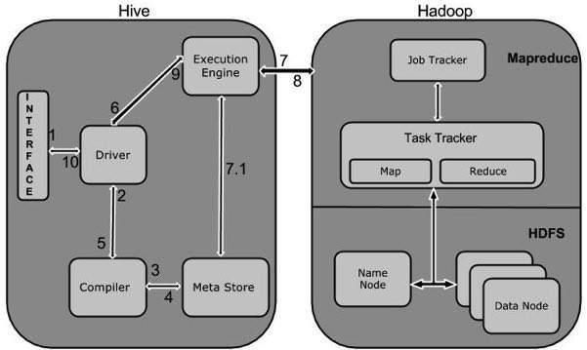
WORKING OF HIVE

Slide 7
INSTALLATION

